Slide 1

SMART INDIA HACKATHON 2026
TITLE PAGE
Problem Statement ID – SIH26090
Problem Statement Title – AI-Driven Market Linkage and Smart Cataloging Mobile Application for Marginalized Artisans
Theme – Heritage and culture
PS Category – Software
Team ID – [Insert Team ID]
Team Name (Registered on portal) – IneffableX
Team Name - IneffableX

Slide 2
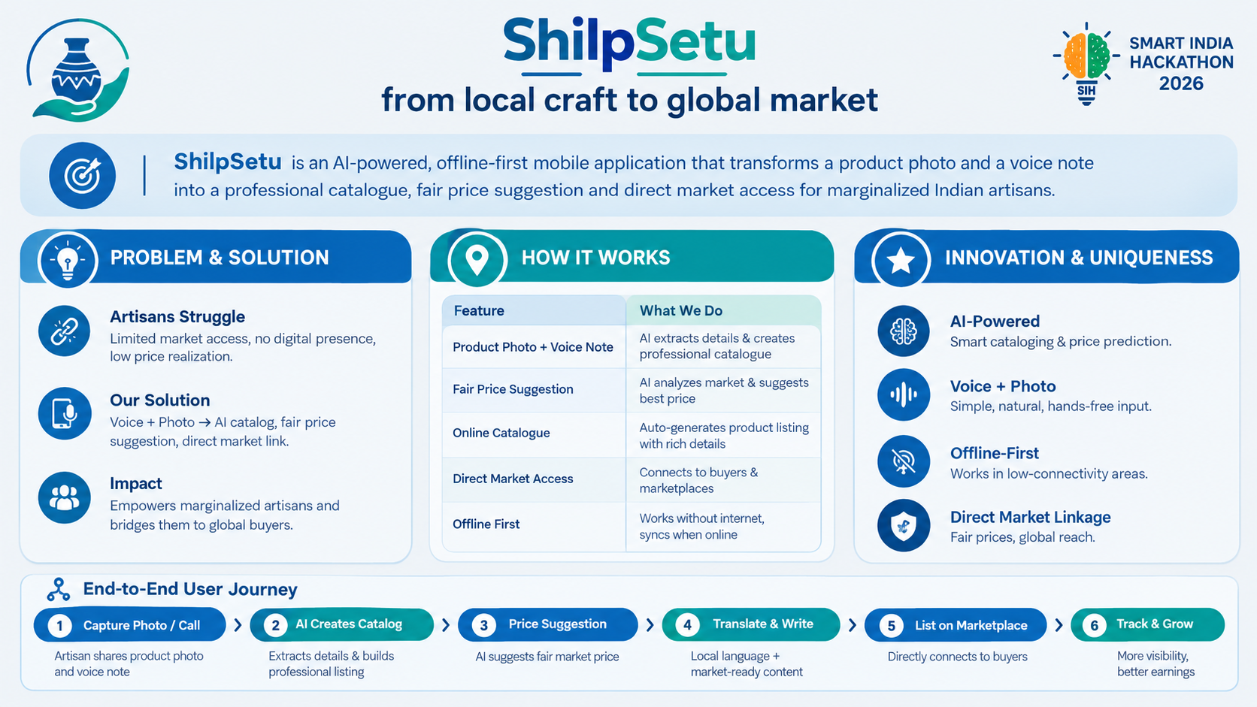

Slide 3
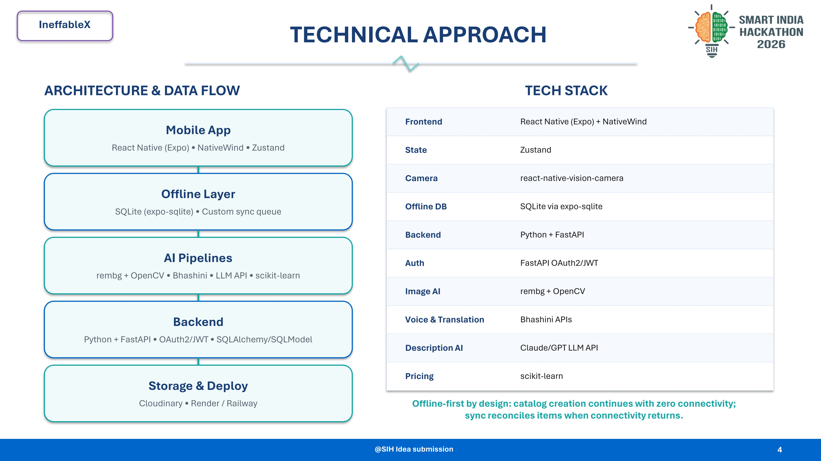

Slide 4







IneffableX
FEASIBILITY AND VIABILITY
Feasibility – Can we build it?
Viability – Can it work in the real world?
Proven AI + Open Source
Simple Adoption
React Native + FastAPI with OpenCV / speech tools
Modular design allows independent feature upgrades
“Speak, Don't Type” voice-first product entry
3 steps: Capture → Speak → Review & Publish
Offline-First & Lightweight
Accessible in Rural Areas
SQLite stores catalog data, photos and audio locally
Sync layer reconciles changes when connectivity returns
Voice interaction supports local accents and low digital literacy
Guided onboarding through SHG / community partners
Low Infrastructure Cost
Scalable & Sustainable
Open-source components reduce software cost
Lightweight backend keeps cloud/hosting overhead low
Works as an MVP and scales feature-by-feature
Partnership model with SHGs, NGOs and artisan cooperatives
KEY RISKS Poor internet → Offline sync • Dialects/noise → ASR + translation • Digital literacy → Guided voice onboarding • Price trust → Explainable price bands
“AI handles the tech — the artisan leads the craft.”
4

Slide 5
IneffableX
IMPACTS AND BENEFITS
IMPACTS
BENEFITS
Continuous, year-round digital market access beyond periodic exhibitions and trade fairs.
Lower the technical barrier to professional product cataloging and online selling.
Improve product presentation through AI-enhanced images and SEO-friendly descriptions.
Support better price discovery using market signals and raw-material cost baselines.
Preserve cultural context through heritage metadata and cluster-based discovery.
Higher visibility for marginalized artisans and micro-entrepreneurs.
Reduced time and effort spent on photography, translation and listing creation.
Regional-language voice interaction makes digital commerce more accessible.
Stronger B2B discovery and pathways to government-supported marketplaces.
A practical digital business companion that can grow with the artisan.
ShilpSetu — turning traditional craftsmanship into sustainable digital opportunity.
5

Slide 6




IneffableX
RESEARCH AND REFERENCES
Research, data sources & technical references
PROBLEM & DOMAIN RESEARCH
GOVERNMENT & MARKET RESEARCH
Ministry of Textiles (Handicrafts): Artisan clusters & export data. handicrafts.nic.in
ICRIER Digital Economy Report 2023: Rural-urban digital access data. icrier.org
IHD x Crafts Council (2026): Craft-sector employment, value-add & e-commerce challenges. researchgate.net
AI in Indian Handicrafts Review (2026): AI opportunities & digital barriers in handicrafts. sciencedirect.com
LEAD, Krea University – Project DIGITAL: Artisan digital readiness in Rajasthan. krea.edu.in
DIGITAL COMMERCE & MARKET LINKAGE
TECHNICAL & RESEARCH REFERENCES
IndiaHandmade: Govt. marketplace for handloom & handicraft artisans. indiahandmade.com
ONDC: Open, interoperable digital commerce network. ondc.org
ONDC x McKinsey (2023): Reforming digital commerce in India. mckinsey.com
Bhashini (MeitY): Indian-language voice & translation. bhashini.gov.in
U2-Net / RemBG (2020): Automated background removal. github.com/danielgatis/rembg
OpenCV: Image processing and computer vision. opencv.org
scikit-learn: Recommendation engine and regression models. scikit-learn.org
SQLite: Local-first storage and offline sync. sqlite.org
Evidence-led • Open-source • Offline-first • Designed for rural artisan adoption

